Slide 1
Spring Framework - II

Slide 2
Agenda
1
Spring MVC
2
Spring Database Interaction

Slide 3
Module 1: Spring - MVC

Slide 4
Objectives
This module is aimed at :
Core Components of Spring MVC
Flow of Request in Spring MVC based Web Application
How to develop a Web Application using Spring MVC

Slide 5
MVC Overview
MVC => Model-View-Controller
Pattern helps to clearly separates business, navigation and presentation logic
Proven mechanism for building a thin & clean web-tier
Three core collaborating components
Controller
Handles navigation logic and interacts with the service tier for business logic
Model
Handles the business logic and data
View
Renders the response to the request
Pulls data from the model
Notes:
“ ”
“ “

Slide 6
Motivation for MVC
Eases maintenance burden
Changes to business logic are less likely to break the presentation logic
Vice versa
Facilitates multi-disciplined team development
Developers can focus on creating robust business code without having to worry about breaking the UI
Designers can focus on building usable and engaging UIs without worrying about Java
Use the best tool for the job
Java is especially suited to creating business logic code
Markup languages are more suited to creating HTML layouts
Ease testability
Business and navigation logic are separated from presentation logic meaning they can be tested separately
Practically: you can test more code outside the servlet container

Slide 7
MVC in Spring
A single Front Controller servlet that dispatches requests to individual Controllers
Proven pattern shown in Struts and Core J2EE Patterns
Request routing is completely controlled by the Front Controller
Individual Controllers can be used to handle many different URLs
Controllers are Classes of Java
Controllers are managed exactly like any other bean in the Spring ApplicationContext

Slide 8
Core Components of Spring MVC
DispatcherServlet
Spring’s Front Controller implementation
Controller
User created component for handling requests
Encapsulates navigation logic
Delegates to the service objects for business logic
The default handler is a very simple Controller interface with method:
ModelAndView handleRequest(request, response).
View
Responsible for rendering output

Slide 9
Core Components of Spring MVC (Contd.).
ModelAndView
Created by the Controller
Stores the Model data
Associates a View to the request (usually a logical view names)
The ModelAndView class is simply a container by which the model may be transported to and exposed by the view.
ViewResolver
Used to map logical View names to actual View implementations
HandlerMapping
Strategy interface used by DispatcherServlet
for mapping incoming requests to individual Controllers

Slide 10
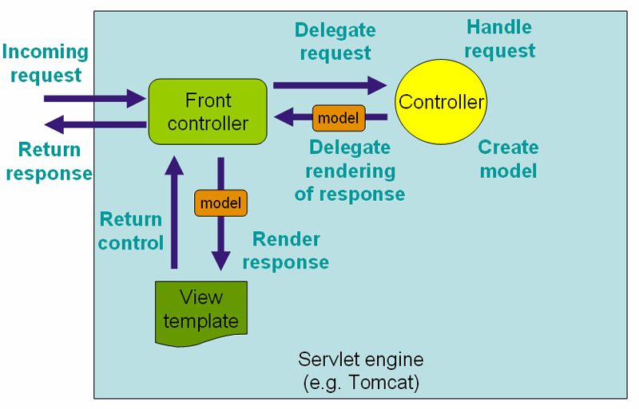
Work Flow in Spring MVC (High Level)
Source: http://static.springframework.org/spring/docs/2.5.x

Slide 11
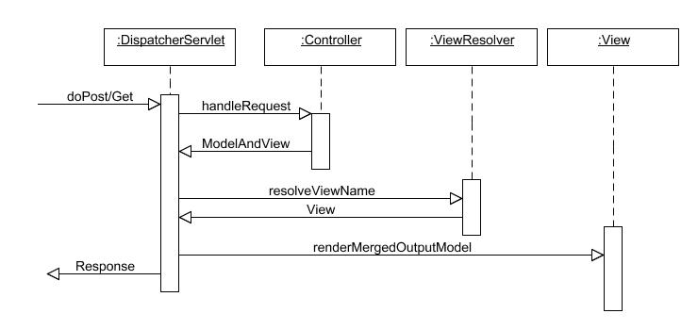
Sequence Diagram of Spring MVC
Source: http://www.theserverside.com/

Slide 12
Lifecycle of a request in Spring MVC
A request leaves the browser asking for a URL and optionally with request parameters.
The request is first examined by DispatcherServlet.
DispatcherServlet consults handler-mappings defined in a configuration file
It selects an appropriate controller and delegates to it to handle therequest.
The controller applies appropriate logic to process the request which results in some information (i.e. model).

Slide 13
Lifecycle of a request in Spring MVC (Contd.).
This information is associated with the logical name of a result rendering entity (i.e. view)
And the whole is returned as a ModelAndView object along with the request back to DispatcherServlet.
DispatcherServlet then consults the logical view name with a view resolving object to determine the actual view implementation to use.
DispatcherServlet delivers the model and request to the view implementation which renders an output and sends it back to the browser.

Slide 14
Configuring Spring-MVC Application
Configure DispatcherServlet in web.xml and establish URL mappings for it.
E.g.:
<servlet>
<servlet-name>springweb</servlet-name>
<servlet-class>org.springframework.web.servlet.DispatcherServlet
</servlet-class> …
Spring configuration metadata in a configuration file named [servlet-name]-servlet.xml in the WEB-INF directory of your web application
E.g.: the DispatcherServlet defined in web.xml with name as springweb, will look for the configuration file /WEB-INF/springweb-servlet.xml
Notes:
Controller Basics
Write a controller and map it to a URL in springweb-servlet.xml
Write the view rendering JSP and map it through a view resolver in
springweb-servlet.xml
The controller class extends AbstractController that deals with the intricacies of Java Servlets. The only method required due to extending AbstractController is handleRequestInternal. You put your controller logic in this method. After setting up some data for the view to render, a ModelAndView object is used to pack the data and specify the logical view name. The data objects are tagged with names that the view can use to pull them out.
The controller completes it work by returning the created ModelAndView object thatDispatcherServlet will use to select a view renderer.
you need to tell Spring MVC in springweb-servlet.xml to use the Controller:
<bean name="/home.htm" class="org.himu.springweb.co.HomePageController"/>

Slide 15
Configuring Spring-MVC Application (Contd.).
When a request is submitted to the server, DispatcherServlet looks in springweb-servlet.xml for a mapping of the specified URL to some controller bean.
This is done by using a BeanNameUrlHandlerMapping class by default.
There are other mapping handlers that you can specify instead of the default. (SimpleUrlHandlerMapping class)
The default handler looks for a bean that has the URL as its name and gives it to DispatcherServlet.
DispatcherServlet looks for a view resolver to resolve the view name that it got from the ModelAndView object - (InternalResourceViewResolver class)
Notes:
Mapping a View :
E.g.:
<bean id="viewResolver"
class="org.springframework.web.servlet.view.InternalResourceViewResolver">
<property name="prefix" value="/jsp/"/>
<property name="suffix" value=".jsp"/>
</bean>
What this resolver does is take the view name, prepend the prefix and append the suffix, and look for a resource with the produced name. So, if you put all your JSP files in the /jsp directory and use their main filename as logical view names then you have got an automatic mapping.

Slide 16
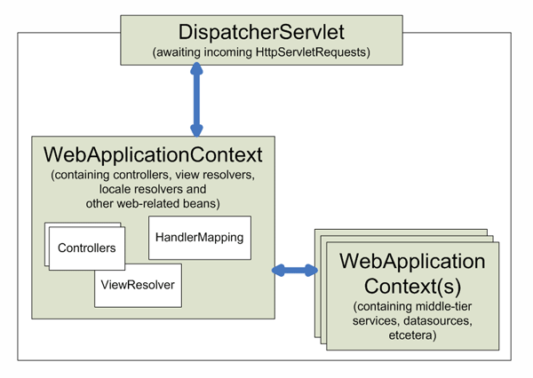
Context hierarchy in Spring Web MVC
Notes:
Web Application Context
The WebApplicationContext is an extension of the plain ApplicationContext that has some extra features necessary for web applications. It differs from a normal ApplicationContext in that it is capable of resolving themes and that it knows which servlet it is associated with (by having a link to the ServletContext). The WebApplicationContext is bound in the ServletContext, and by using static methods on the RequestContextUtils class you can always lookup the WebApplicationContext in case you need access to it.

Slide 17
Controller(s) in Spring-MVC
Spring's Web MVC framework is designed around a DispatcherServlet that dispatches requests to handlers (Controllers)
The default handler is a very simple Controller interface, just offeringthe below method :
ModelAndView handleRequest(request,response)
Application Controllers are typically sub-classes of the included implementation hierarchy, consisting of:
AbstractController
AbstractCommandController
SimpleFormController
Notes:
Controllers provide access to the application behavior which is typically defined by a service interface.
Controllers interpret user input and transform such input into a sensible model which will be represented to the user by the view. Spring has implemented the notion of a controller in a very abstract way enabling a wide variety of different kinds of controllers to be created. Spring contains form-specific controllers, command-based controllers, and controllers that execute wizard-style logic, to name but a few.
Spring's basis for the controller architecture is the org.springframework.web.servlet.mvc.Controller interface.
The Controller interface defines a single method that is responsible for handling a request and returning an appropriate model and view. These three concepts are the basis for the Spring MVC implementation - ModelAndView and Controller. While the Controller interface is quite abstract, Spring offers a lot of Controller implementations out of the box that already contain a lot of the functionality you might need. The Controller interface just defines the most basic responsibility required of every controller; namely handling a request and returning a model and a view.

Slide 18
Command controllers
Spring's command controllers are a fundamental part of the Spring Web MVC package.
Command controllers provide a way to interact with data objects and dynamically bind parameters from the HttpServletRequest to the data object specified.
They perform a somewhat similar role to the Struts ActionForm, but in Spring, your data objects don't have to implement a framework-specific interface.
Built-in Classes:
AbstractCommandController
AbstractFormController
SimpleFormController
AbstractWizardFormController
Notes:
The list of classes of type – Command Controllers:
AbstractCommandController -a command controller you can use to create your own command controller, capable of binding request parameters to a data object you specify. This class does not offer form functionality; it does however offer validation features and lets you specify in the controller itself what to do with the command object that has been populated with request parameter values.
BaseCommandController
● Controller implementation which–Creates an object (the command object) on receipt of a request & Populates command object with request parameters
AbstractFormController -an abstract controller offering form submission support. Using this controller you can model forms and populate them using a command object you retrieve in the controller. After a user has filled the form, the AbstractFormController binds the fields, validates the command object, and hands the object back to the controller to take the appropriate action. Supported features are: invalid form submission (resubmission), validation, and normal form workflow. You implement methods to determine which views are used for form presentation and success. Use this controller if you need forms, but don't want to specify what views you're going to show the user in the application context.

Slide 19
Command controllers (Contd.).
AbstractController
BaseCommandController
AbstractCommandController
AbstractFormController
SimpleFormController
AbstractWizardController
MultiActionController
ParameterizableViewController
Notes:
SimpleFormController -a form controller that provides even more support when creating a form with a corresponding command object. The SimpleFormController let's you specify a command object, a viewname for the form, a viewname for page you want to show the user when form submission has succeeded, and more.
AbstractWizardFormController - as the class name suggests, this is an abstract class -your wizard controller should extend it. This means you have to implement the validatePage(), processFinish() and processCancel() methods.

Slide 20
Handler Mapping
Using a handler mapping you can map incoming web requests to appropriate handlers
When a request comes in, the DispatcherServlet will hand it over to the handler mapping
It lets the HandlerMapping inspect the request and come up with an appropriate HandlerExecutionChain.
Then the DispatcherServlet will execute the handler and interceptors in the chain (if any).
There are some handler mappings you can use out of the box:
SimpleUrlHandlerMapping
BeanNameUrlHandlerMapping (default)
Notes:
BeanNameUrlHandlerMapping
A very simple, but very powerful handler mapping is the BeanNameUrlHandlerMapping, which maps incoming HTTP requests to names of beans, defined in the web application context.
<beans>
<bean id="handlerMapping" class = "org.springframework.web.servlet.handler.BeanNameUrlHandlerMapping"/>
<bean name="/editaccount.form" class = "org.springframework.web.servlet.mvc.SimpleFormController">
<property name="formView" value="account"/>
<property name="successView" value="account-created"/>
<property name="commandName" value="account"/>
<property name="commandClass" value="samples.Account"/>
</bean>
<beans>
All incoming requests for the URL /editaccount.form will now be handled by the form Controller.

Slide 21
Notes:
SimpleUrlHandlerMapping
A further - and much more powerful handler mapping - is the SimpleUrlHandlerMapping. This mapping is configurable in the application context and has Ant-style path matching capabilities.
Example:
<beans>
<!-- no 'id' required, HandlerMapping beans are automatically detected by the DispatcherServlet -->
<bean class="org.springframework.web.servlet.handler.SimpleUrlHandlerMapping">
<property name="mappings">
<value>
/*/account.form=editAccountFormController
/*/editaccount.form=editAccountFormController /ex/view*.html = helpController
/**/help.html=helpController
</value>
</property>
</bean>
<bean id="helpController" class = "org.springframework.web.servlet.mvc.UrlFilenameViewController"/>
<bean id="editAccountFormController" class = "org.springframework.web.servlet.mvc.SimpleFormController">
<property name="formView" value="account"/>
<property name="successView" value="account-created"/>
<property name="commandName" value="Account"/> <property name="commandClass" value="samples.Account"/>
</bean>
<beans>
This handler mapping routes requests for 'help.html' in any directory to the 'helpController', which is a UrlFilenameViewController. Requests for a resource beginning with 'view', and ending with '.html' in the directory 'ex' will be routed to the 'helpController'.

Slide 22
Notes:
Another Example configuration file, using InternalResourceViewResolver:
<?xml version="1.0" encoding="UTF-8"?> <!DOCTYPE beans PUBLIC "-//SPRING//DTD BEAN//EN" "http://www.springframework.org/dtd/spring-beans.dtd">
<beans>
<bean id="simpleUrlMapping"
class="org.springframework.web.servlet.handler.SimpleUrlHandlerMapping">
<property name="mappings">
<props>
<prop key="/login.html">loginBankController</prop>
</props>
</property>
</bean>
<bean id="logonValidator" class="springexample.commands.LogonValidator"/>
<!-- LoginBankController is a SimpleFormController -->
<bean id="loginBankController"
class="springexample.contoller.LoginBankController">
<property name="sessionForm">
<value>true</value>
</property>
<!-- This is Command object. The command object can be
accessed in a view through <spring:bind path="loginCommand"> -->
<property name="commandName">
<value>loginCommand</value>
</property>
<property name="commandClass">
<value>springexample.commands.LoginCommand</value>
</property>
<property name="validator">
<ref bean="logonValidator"/>
</property>

Slide 23
Notes:
<!-- Indicates what view to use when the user asks for a new form
or when validation errors have occurred on form submission. -->
<property name="formView">
<value>login</value>
</property>
<!-- Indicates what view to use when successful form submissions
have occurred. Such a success view could e.g. display a submission
summary. More sophisticated actions can be implemented by
overriding one of the onSubmit() methods.-->
<property name="successView">
<value>accountdetail</value>
</property>
<property name="authenticationService">
<ref bean="authenticationService" />
</property>
<property name="accountServices">
<ref bean="accountServices" />
</property>
</bean>
<bean id="viewResolver"
class="org.springframework.web.servlet.view.InternalResourceViewResolver">
<property name="viewClass">
<value>org.springframework.web.servlet.view.JstlView</value>
</property>
<property name="prefix">
<value>/jsp/</value>
</property>
<property name="suffix">
<value>.jsp</value>
</property>
</bean>
</beans>

Slide 24
Intercepting requests
Spring's handler mapping mechanism has the notion of handler interceptors
Interceptors located in the handler mapping must implement HandlerInterceptor from the org.springframework.web.servlet package.
This interface defines three methods:
boolean preHandle(HttpServletRequest request, HttpServletResponse response, Object handler) throws Exception;
void postHandle( HttpServletRequest request, HttpServletResponse response, Object handler, ModelAndView modelAndView) throws Exception;
void afterCompletion( HttpServletRequest request, HttpServletResponse response, Object handler, Exception ex) throws Exception;
Spring has an adapter class - named HandlerInterceptorAdapter, to make it easier to extend the HandlerInterceptor interface.
Notes:
HandlerInterceptor
This interface defines three methods, one that will be called before the actual handlerwill be executed, one that will be called after the handler is executed, and one that is called after the complete request has finished. These three methods should provide enough flexibility to do all kinds of pre- and post-processing.
The preHandle(..) method returns a boolean value. You can use this method to break or continue the processing of the execution chain. When this method returns true, the handler execution chain will continue, when it returns false, the DispatcherServletassumes the interceptor itself has taken care of requests (and, for example, rendered an appropriate view) and does not continue executing the other interceptors and the actual handler in the execution chain.
Example:
The following example provides an interceptor that intercepts all requests and reroutes the user to a specific page if the time is not between 9 a.m. and 6 p.m.

Slide 25
Notes:
.java file:
package samples;
public class TimeBasedAccessInterceptor extends HandlerInterceptorAdapter
{
private int openingTime;
private int closingTime;
public void setOpeningTime(int openingTime)
{ this.openingTime = openingTime; }
public void setClosingTime(int closingTime) { this.closingTime = closingTime; }
public boolean preHandle( HttpServletRequest request, HttpServletResponse response, Object handler) throws Exception
{
Calendar cal = Calendar.getInstance();
int hour = cal.get(HOUR_OF_DAY);
if (openingTime <= hour < closingTime) { return true; }
else
{ response.sendRedirect("http://host.com/outsideOfficeHours.html"); return false;
}
}
}
Any request coming in, will be intercepted by the TimeBasedAccessInterceptor, and if the current time is outside office hours, the user will be redirected to a static html file, saying, for example, he can only access the website during office hours.

Slide 26
Summary
In this module, we have learnt :
Core Components of Spring MVC
Flow of Request in Spring MVC based Web Application
How to develop a Web Application using Spring MVC

Slide 27
Module 2: Spring Database Interaction

Slide 28
Objectives
This module is aimed at:
Understanding Spring interaction with database using
JDBC
ORM (Hibernate)

Slide 29
Spring JDBCTemplate
JDBCTemplate class is the central class in the JDBC core package.
It simplifies the use of JDBC in Spring applications by handlingthe creation and release of resources.
This class performs basic tasks of core JDBC workflow like SQL statement creation and execution.
This class executes SQL queries, update statements and stored procedure calls, performs iteration over ResultSets and extraction of returned parameter values and catch and handle JDBC exceptions.

Slide 30
Integrating Hibernate with Spring
The Spring Framework provides integration with Hibernate, in terms of:
Resource management
DAO implementation support
transaction strategies
There are usually two integration styles:
using Spring's DAO 'templates' (helper classes)
or coding DAOs against plain Hibernate/JDO/TopLink/etc APIs.
In both cases, DAOs can be configured through Dependency Injection and participate in Spring's resource and transaction management.
Notes:
Some of the benefits of using the Spring Framework to create your ORM DAOs include:
Ease of testing. Spring's IoC approach makes it easy to swap the implementations and config locations of Hibernate SessionFactory instances, JDBC DataSource instances, transaction managers, and mapper object implementations (if needed). This makes it much easier to isolate and test each piece of persistence-related code in isolation.
Common data access exceptions. Spring can wrap exceptions from your O/R mapping tool of choice, converting them from proprietary (potentially checked) exceptions to acommon runtime DataAccessException hierarchy. This allows you to handle most persistence exceptions, which are non-recoverable, only in the appropriate layers, without annoying boilerplate catches/throws, and exception declarations. You can still trap and handle exceptions anywhere you need to. Remember that JDBC exceptions (including DB specific dialects) are also converted to the same hierarchy, meaning that you can perform some operations with JDBC within a consistent programming model.

Slide 31
Notes:
General resource management. Spring application contexts can handle the location and configuration of Hibernate SessionFactory instances, JDBC DataSource instances, iBATIS SQL Maps configuration objects, and other related resources. This makes these values easy to manage and change. Spring offers efficient, easy and safe handling of persistence resources.
For example: related code using Hibernate generally needs to use the same Hibernate Session for efficiency and proper transaction handling. Spring makes it easy to transparently create and bind a Session to the current thread, either by using an explicit 'template' wrapper class at the Java code level or by exposing a current Session through the Hibernate SessionFactory (for DAOs based on plain Hibernate API). Thus Spring solves many of the issues that repeatedly arise from typical Hibernate usage, for any transaction environment (local or JTA).
Integrated transaction management. Spring allows you to wrap your O/R mapping code with either a declarative, AOP style method interceptor, or an explicit 'template' wrapper class at the Java code level. In either case, transaction semantics are handled for you, and proper transaction handling (rollback, etc) in case of exceptions is taken care of. As discussed below, you also get the benefit of being able to use and swap various transaction managers, without your Hibernate/JDO related code being affected:
for example, between local transactions and JTA, with the same full services (such as declarative transactions) available in both scenarios.
As an additional benefit, JDBC-related code can fully integrate transactionally with the code you use to do O/R mapping. This is useful for data access that's not suitable for O/R mapping, such as batch processing or streaming of BLOBs, which still needs toshare common transactions with ORM operations.

Slide 32
Spring support for Hibernate
All the individual data access features are usable on their own but integrate nicely with Spring's application context concept
Provides XML-based configuration and cross-referencing of plain JavaBean instances that don't need to be Spring-aware
OR mapping inside an ApplicationContext or BeanFactory yields the benefits of ease of configuration and deployment.
Spring AOP provides several aspects that make it possible to declaretransaction policies for JavaBeans
TransactionProxyFactoryBean is a convenience proxy class that can intercept method calls to an existing class and apply a transaction context to a transaction bean.
Notes:
JDBC DataSource and HibernateSessionFactory wiring <!-- DataSource Property -->
<bean id="exampleDataSource" class="org.apache.commons.dbcp.BasicDataSource">
<property name="driverClassName">
<value>org.apache.derby.jdbc.EmbeddedDriver</value>
</property>
<property name="url">
<value>jdbc:derby:springexample;create=true</value>
</property>
</bean> <!-- Database Property -->
<bean id="exampleHibernateProperties" class = "org.springframework.beans.factory.config.PropertiesFactoryBean"> <property name="properties">
<props>
<prop key="hibernate.hbm2ddl.auto">update</prop>

Slide 33
Spring support for Hibernate (Contd.).
Spring allows you to define resources such as a JDBC DataSource or a Hibernate SessionFactory as beans in the Spring container
Application objects that need to access resources simply receive references to such pre-defined instances through bean references
Spring offers Hibernate support, consisting of:
HibernateTemplate
HibernateInterceptor
Hibernate transaction manager
Notes:
<prop key="hibernate.dialect">net.sf.hibernate.dialect.DerbyDialect</prop>
<prop key="hibernate.query.substitutions">true 'T', false 'F'</prop>
<prop key="hibernate.show_sql">false</prop>
<prop key="hibernate.c3p0.minPoolSize">5</prop>
<prop key="hibernate.c3p0.maxPoolSize">20</prop>
<prop key="hibernate.c3p0.timeout">600</prop>
<prop key="hibernate.c3p0.max_statement">50</prop>
<prop key="hibernate.c3p0.testConnectionOnCheckout">false</prop>
</props>
</property>
</bean>
<!-- Hibernate SessionFactory -->
<bean id="exampleSessionFactory" class = "org.springframework.orm.hibernate.LocalSessionFactoryBean">
<property name="dataSource">
<ref local="exampleDataSource"/>
</property>
<property name="hibernateProperties">
<ref bean="exampleHibernateProperties" />
</property> <!-- OR mapping files. -->
<property name="mappingResources">
<list> <value>Customer.hbm.xml</value> <value>Account.hbm.xml</value>
</list>
</property>
</bean>

Slide 34
Hibernate Template
The HibernateTemplate class provides many methods that mirror the methods exposed on the Hibernate Session interface
HibernateTemplate will ensure that Session instances are properly opened and closed, and automatically participate in transactions.
The template instances are thread-safe and reusable, they can thus be kept as instance variables of the surrounding class
The ‘SessionFactory’ bean can be injected into DAO setter method, which is required for creating HibernateTemplate object
If you need access to the Session to invoke methods that are not exposed on the HibernateTemplate, you can always drop down to a callback-based approach
Notes:
<beans>
<bean id="myProductDao" class="product.ProductDaoImpl">
<property name="sessionFactory" ref="mySessionFactory"/>
</bean>
</beans>
public class ProductDaoImpl implements ProductDao
{ private HibernateTemplate hibernateTemplate;
public void setSessionFactory(SessionFactory sessionFactory)
{ this.hibernateTemplate = new HibernateTemplate(sessionFactory);
}
public Collection loadProductsByCategory(String category) throws DataAccessException
{ return this.hibernateTemplate.find("from test.Product product where product.category=?", category);
}
}

Slide 35
Hibernate Template (Contd.).
A callback implementation effectively can be used for any Hibernatedata access.
E.g.:
public Collection loadProductsByCategory(final String category) throws DataAccessException
{
return this.hibernateTemplate.execute(new HibernateCallback()
{ public Object doInHibernate(Session session)
{ Criteria criteria = session.createCriteria(Product.class); criteria.add(Expression.eq("category",category)); criteria.setMaxResults(6);
return criteria.list();
}
};
}
Notes:
E.g.: The bean configuration file will have one of the beans definition for the Class in which HibernateTemplate is used, as below:
<bean id="DaoTarget" class="springhibernate.UserDAOImpl“ >
<property name="hibernateTemplate">
<ref bean="hibernateTemplate"/>
</property>
</bean>

Slide 36
Spring-based DAOs without Hibernate callbacks
As alternative to using Spring's HibernateTemplate to implement DAOs, data access code can also be written in a more traditional fashion :
without wrapping the Hibernate access code in a callback
while still respecting and participating in Spring's generic DataAccessException hierarchy
The HibernateDaoSupport class, which will be the base class, offers methods to access the current transactional Session
Also available static helpers on the SessionFactoryUtils class (similar to HibernateUtil)
The advantage of such direct Hibernate access code is that it allows any checked application exception to be thrown within the data access code

Slide 37
Spring-based DAOs without Hibernate callbacks (Contd.).
Spring provides a convenient HibernateDaoSupport base class that provides:
a setSessionFactory(..) method for receiving a SessionFactory
getSessionFactory() and getHibernateTemplate() for use by subclasses.
This allows for very simple DAO implementations for typical requirements:
E.g.:
public class ProductDaoImpl extends HibernateDaoSupport implements ProductDao
{ public Collection loadProductsByCategory(String category) throws DataAccessException
{ return this.getHibernateTemplate().find( "from test.Product product where product.category=?", category);
}
}
Notes:
E.g.: The bean for a class that is derived from HibernateDaoSupport, should be defined as below:
<bean id="DaoTarget1" class="springhibernate.UserDAOImpl1">
<property name="sessionFactory">
<ref bean="sessionFactory"/>
</property>
<property name="hibernateTemplate">
<ref bean="hibernateTemplate"/>
</property>
</bean>
And the class should have a member of SessionFactory type (but not of HibernateTemplate type !) and no Setter & getter methods.

Slide 38
Implementing DAOs based on Hibernate API
Spring provides synchronization of one Hibernate Session per transaction
A simple DAO implementation class can make use of this Hibernate Session object (through Dependency Injection)
Hibernate API then can be used within DAO
The main advantage of this DAO style is that it depends on HibernateAPI only; no import of any Spring class is required
DAOs can be implemented based on the plain Hibernate 3 API, whilestill being able to participate in Spring-managed transactions.
Notes:
E.g.:
public class ProductDaoImpl implements ProductDao
{ private SessionFactory sessionFactory;
public void setSessionFactory(SessionFactory sessionFactory)
{ this.sessionFactory = sessionFactory; }
public Collection loadProductsByCategory(String category)
{ return this.sessionFactory.getCurrentSession()
.createQuery("from test.Product product where product.category=?") .setParameter(0, category)
.list(); }
}

Slide 39
Summary
In this module, we have learnt:
Understanding Spring interaction with database using
JDBC
ORM (Hibernate)

Slide 40
References
http://www.theserverside.com/tt/articles/article.tss?l=SpringFramework
http://static.springframework.org/spring/docs/
http://www.javabeat.net/articles/71-introduction-to-spring-web-framework-3.html
http://www.java2s.com/Code/Java/Hibernate/HibernateSpringHibernateTemplateFind.htm

Slide 41
Thank You

